Slide 1
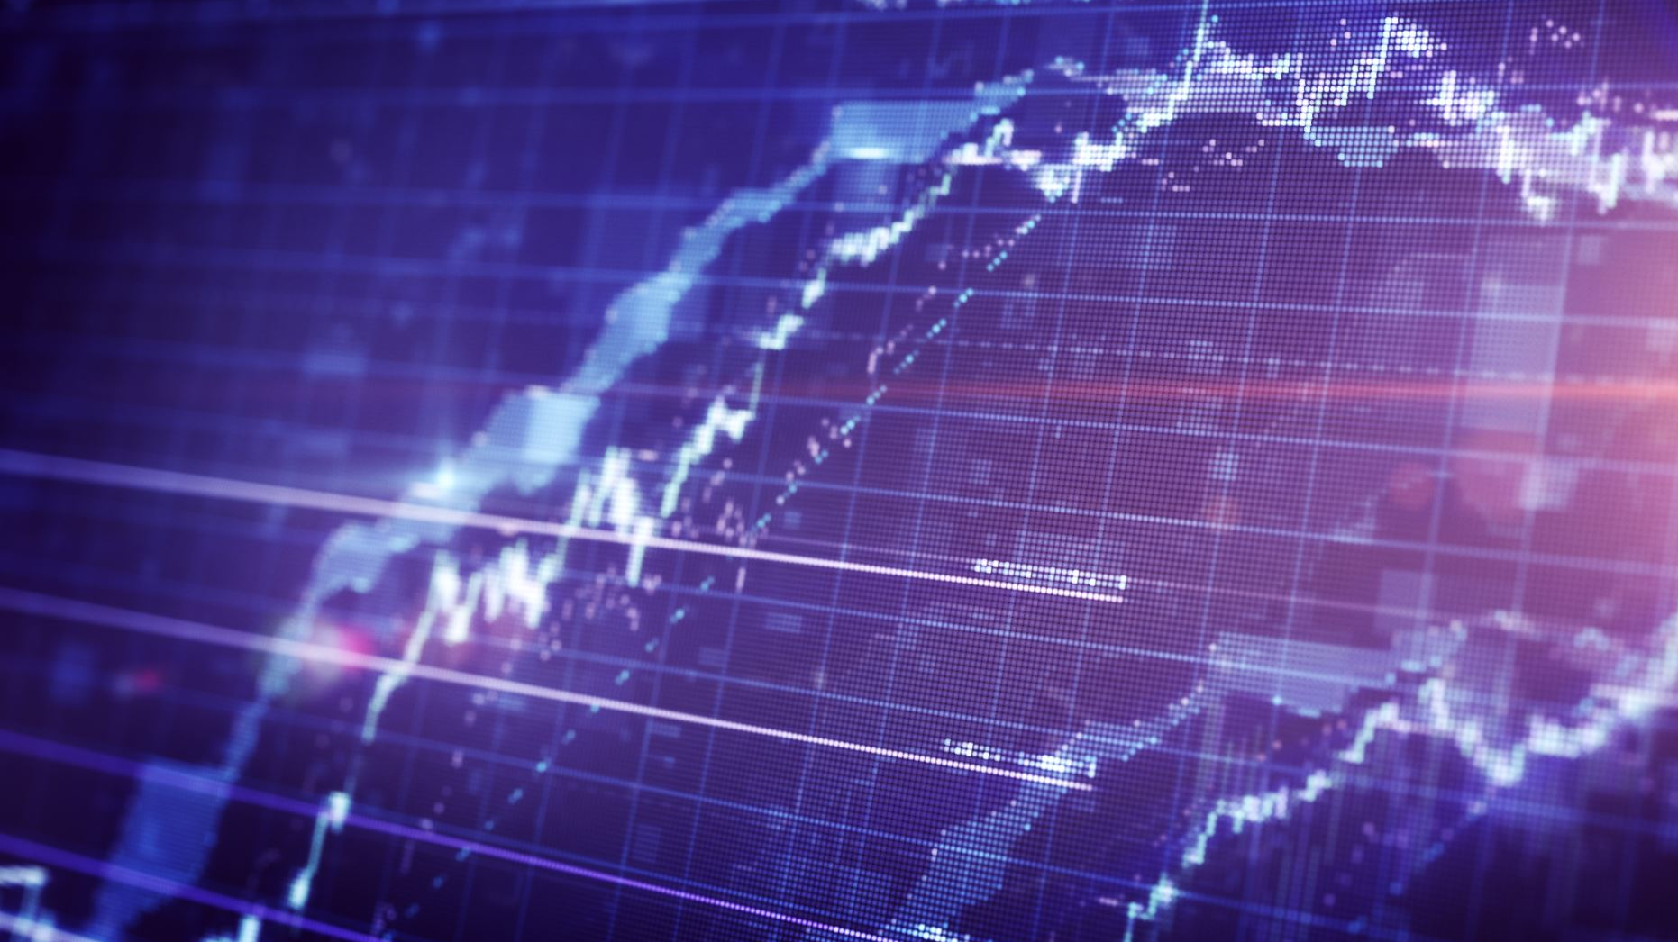
DJI Price Direction Prediction though Natural Language Processing
Ethan Koh, 29 June 2020

Slide 2
Dow Jones Industrial Average (DJIA) is a stock market index that measures the stock performance of 30 large companies listed on stock exchanges in the United States.

Slide 3
Have you ever thought of putting some savings into the stock market though you may have little knowledge?

Slide 4

Well, I watch the world news daily. That should be a good reflection of how the economy is moving, and hence stock prices.

Slide 5

Goal
Using the top 25 up voted world news title from Reddit users under the subreddit r/worldnews, we are going to explore and build a model in predicting whether Dow Jones Index(DJI) will increase, decrease or remain the same from the previous trading day.
Target Audience: investors who might seek to include news in their prediction model

Slide 6
Dataset
First date: 2008-08-08
Last date: 2016-07-01
25 News Title Per Trading Day from Reddit
Close to 2000 trading days before splitting into train and test set

Slide 7
Cleaning
Remove
Remove HTML, if any
Remove
Remove stopwords first before removing non-letters
Remove
Remove non-letters and numbers except full stop
Convert
Convert to lower case
Tokenize
Tokenize: Split sentence into words
Lemmatize
Lemmatize list of words and join
Remove
Remove full stop only

Slide 8
Train Test set (80-20)
Number of Trading days in Train set: 1591
Number of Trading Days in Train set: 398

Slide 9
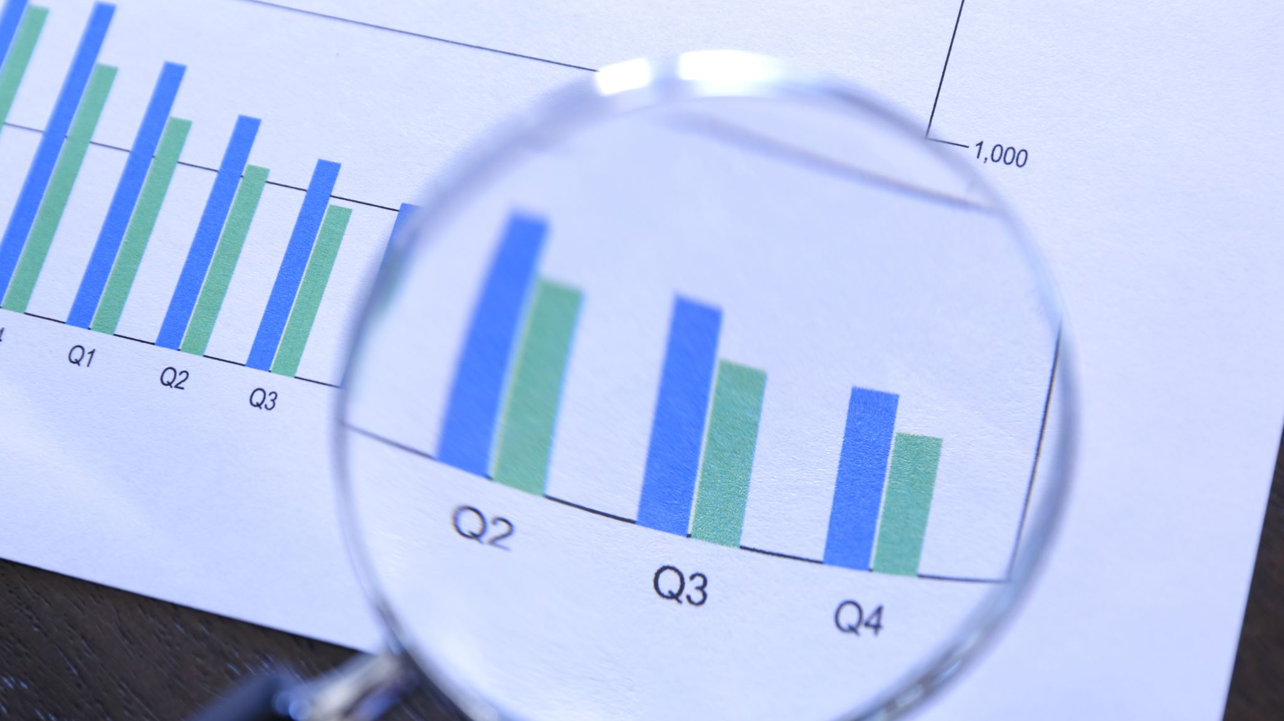
Exploratory Data Analysis

Slide 10
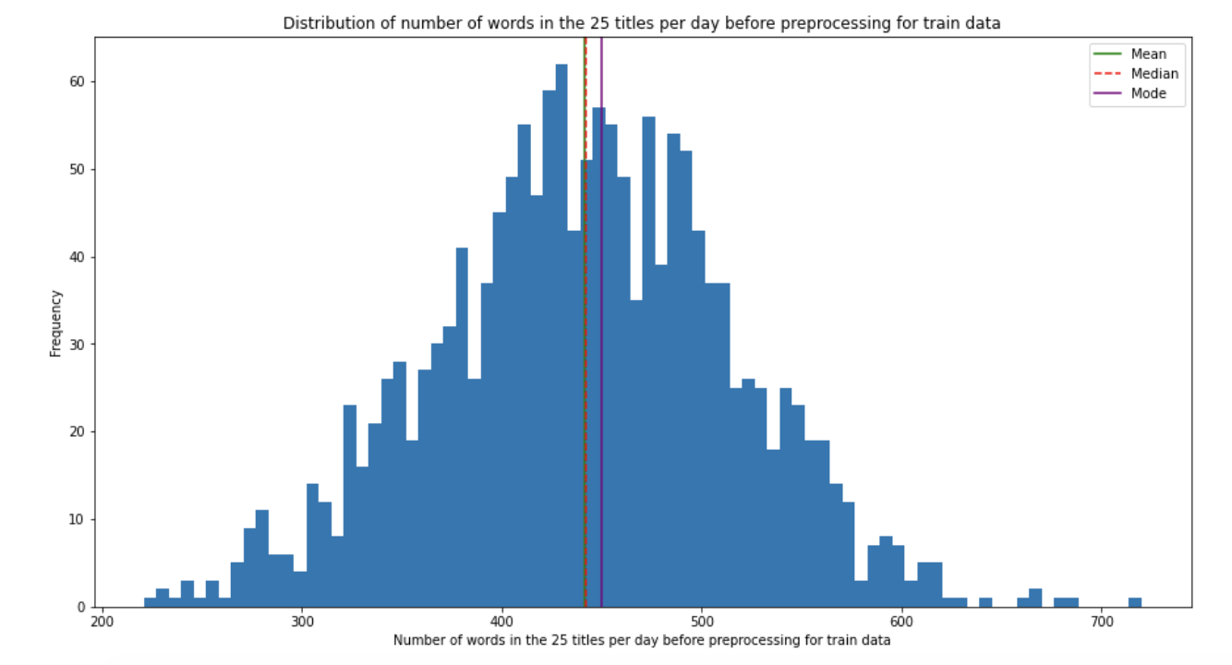

Slide 11
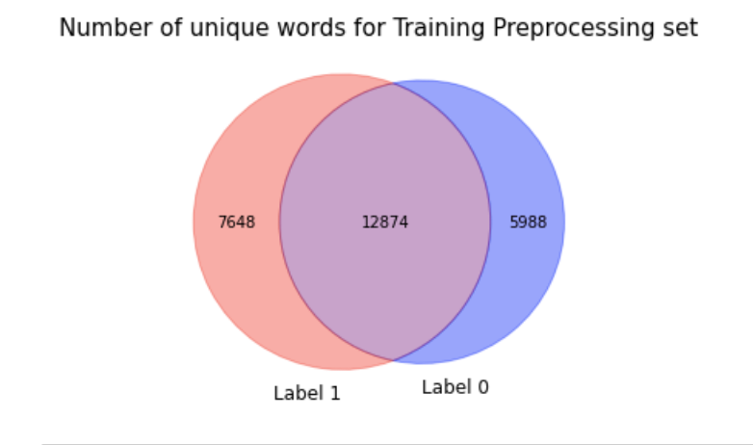

Slide 12
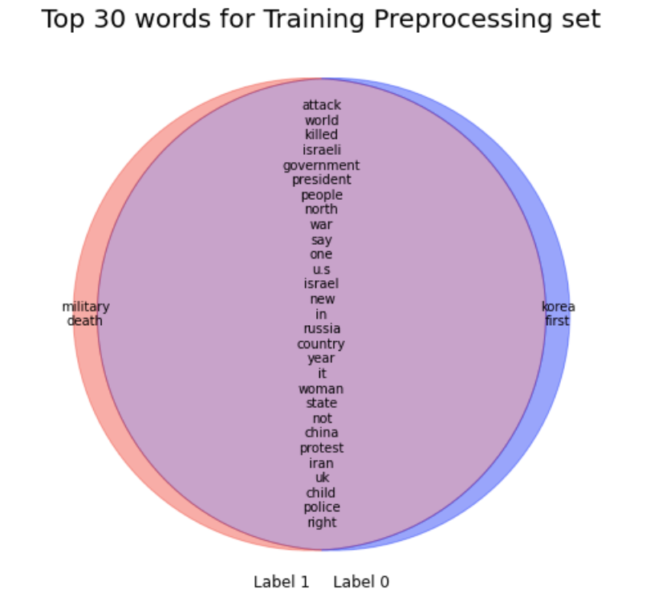

Slide 13
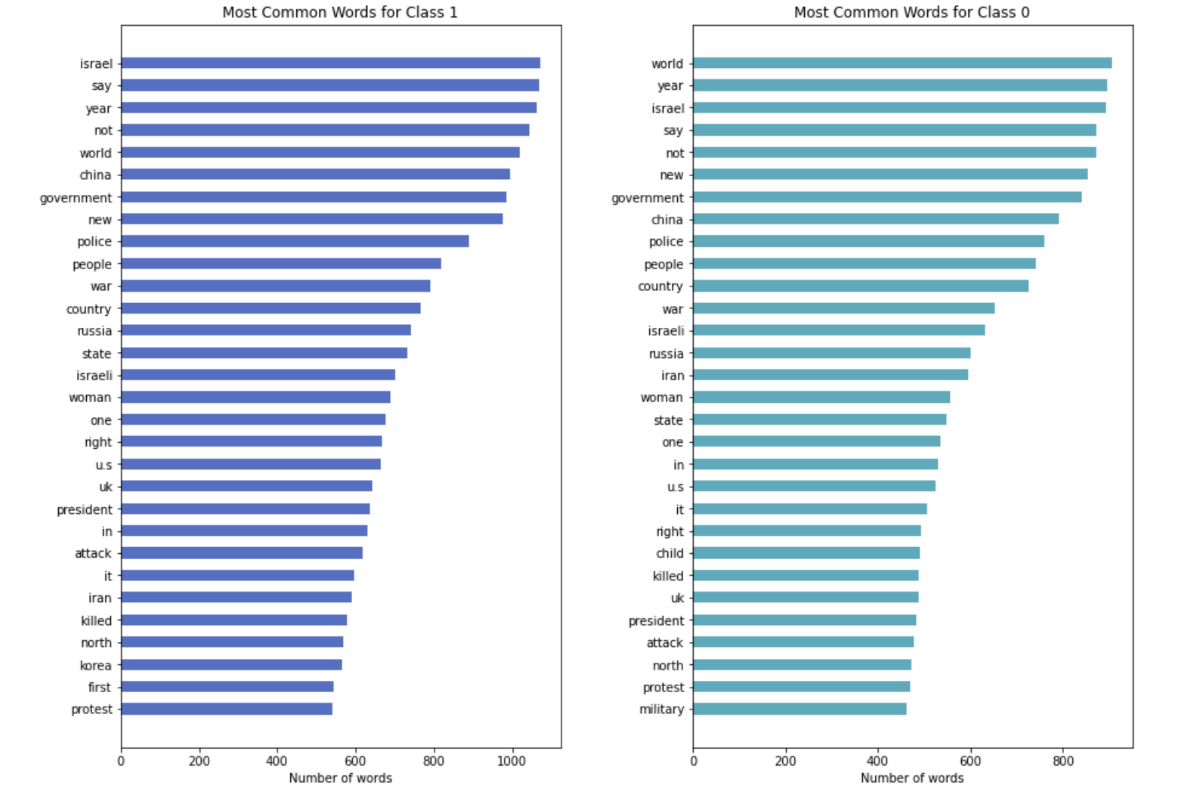
Uni-gram

Slide 14
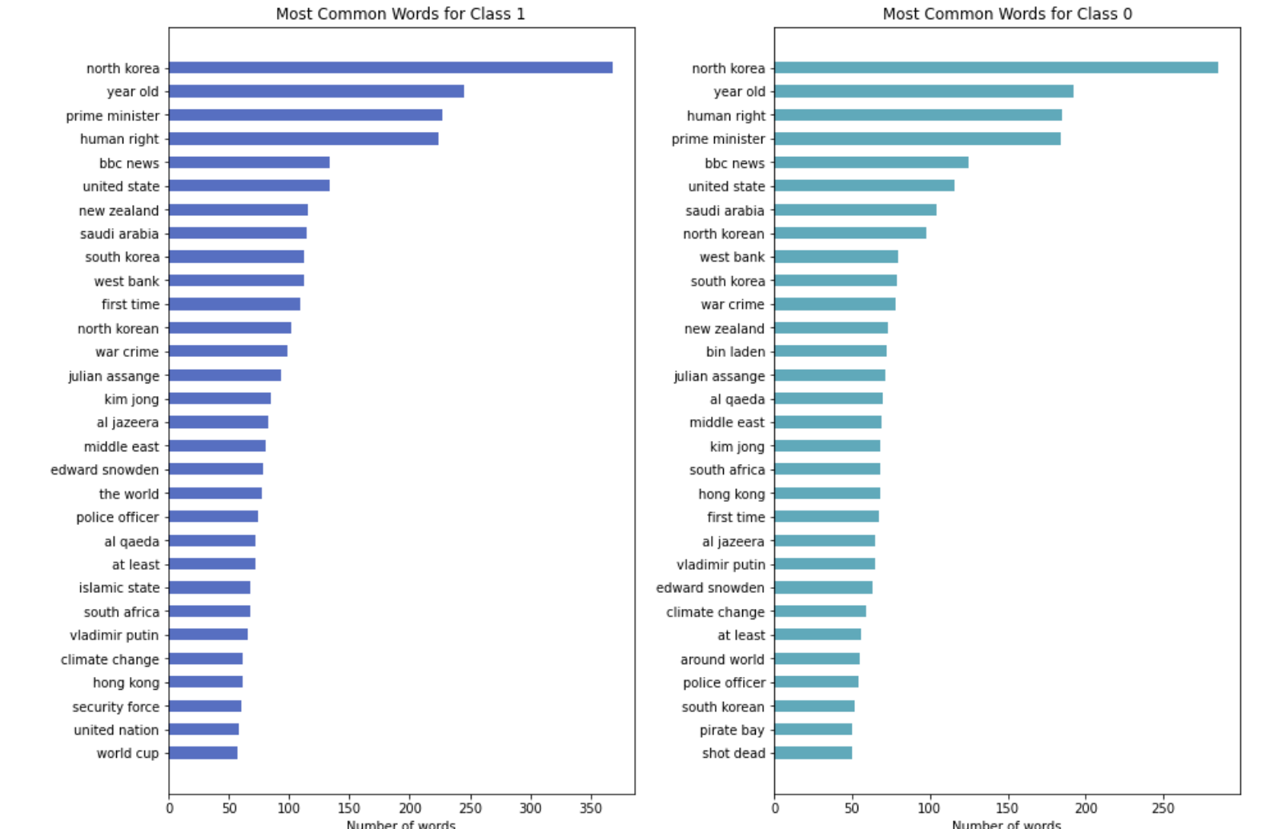
Bi-gram

Slide 15
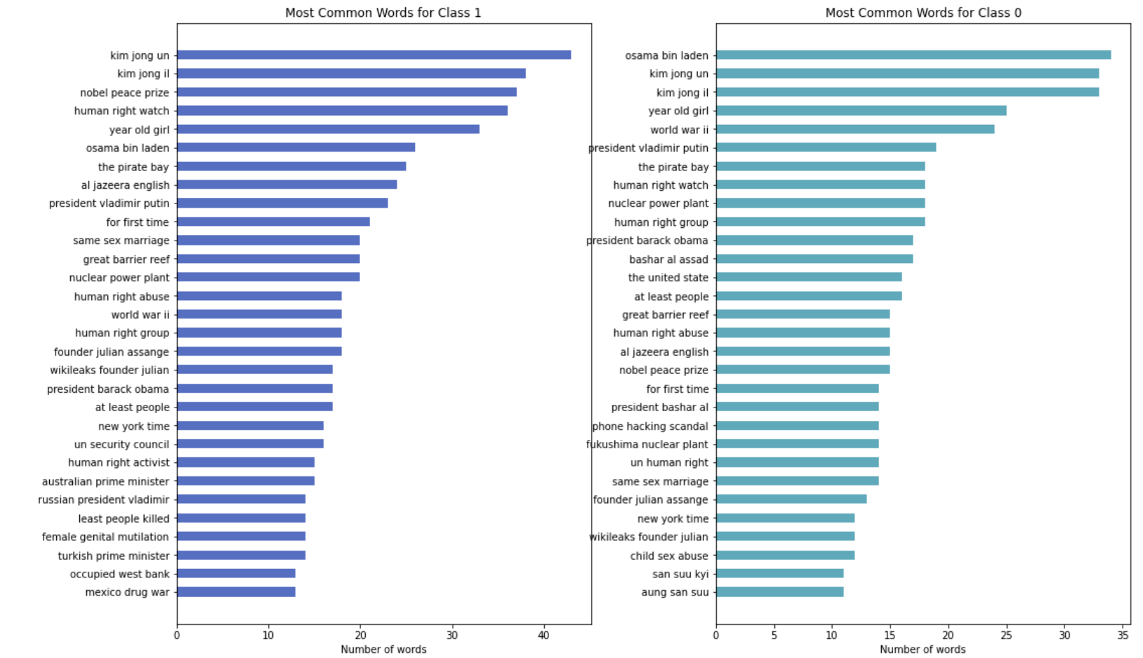
Tri-gram

Slide 16

Baseline Model
0.542426

Slide 17
Pipeline
Vectorizer
Model

Slide 18
 | Logistic with Cvec 1-gram | Logistic with Cvec 2-gram | Logistic with Cvec 3-gram | Logistic with Tvec 2-gram | Random Forest with Tvec 1-gram | Random Forest with Cvec 2-gram | Naive Bayes with Cvec 2-gram
CV score | 0.54242 | 0.54242 | 0.51538 | 0.54116 | 0.54242 | 0.54242 | 0.54555
Training Accuracy Score | 0.54242 | 0.54242 | 0.62539 | 0.56693 | 0.54305 | 0.54242 | 0.62162
Testing Accuracy Score | 0.50753 | 0.50753 | 0.51507 | 0.50251 | 0.50753 | 0.50753 | 0.50502

Slide 19

TextBlob
Gives the sentiment of each sentence and giving it a score between -1 and 1.

Slide 20
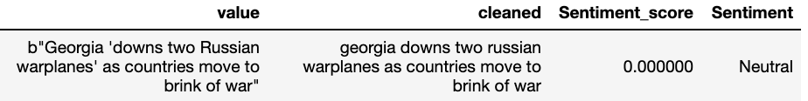
Examples of Sentiments

Slide 21
 | Logistic Regression
CV score | 0.54242
Training Accuracy Score | 0.54242
Testing Accuracy Score | 0.50757

Slide 22

Logistic with Cvec 3-gram

Slide 23
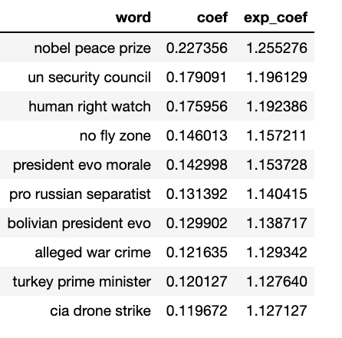
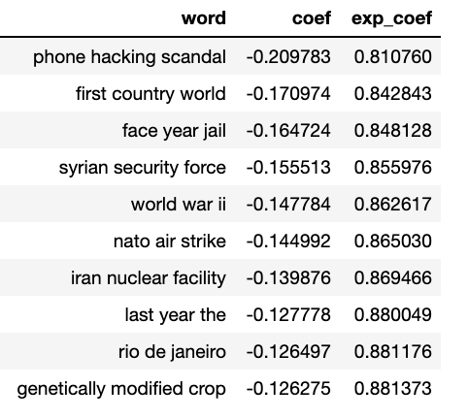
Coef. Contribute to class =1
Coef. Contribute to class =0

Slide 24
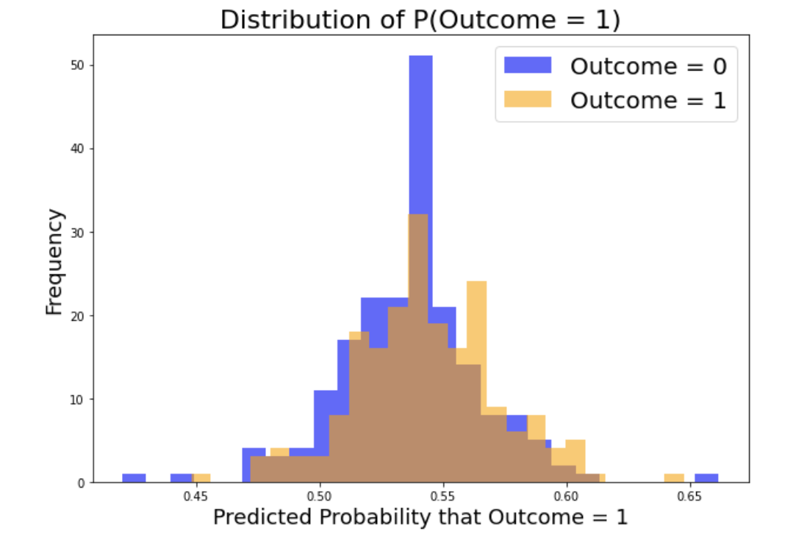

Slide 25
Conclusion
The best model, though below baseline model, was using 3 ngram CountVectorizer with Logisitic Regression with testing accuracy score of 0.5150. Though the classification model was not successful, a glimpse into the EDA provided some interesting observations.
01
Sentimental Analysis using TextBlob was then used to give sentiment scores to the news to model instead of relying on just vectorizing tools from Natural Language Processing. Looking at the sentimental score EDA suggests that many titles were give neutral sentiment of score 0.
02
We can conclude that watching daily everyday news alone might not be sufficient to decide whether prices are trending upwards or downwards at any given day. Thus, more precaution and work has to be done while trading in stock market. One should not simply trade based on watching daily world news.
03

Slide 26
Recommendations
Taking a larger corpus such as full news articles instead of titles, longer period of time, more sources
Adapting 'syuzhet' R package to give a wide range of emotions in addition to sentiments to feed into modeling: eight emotions (anger, fear, anticipation, trust, surprise, sadness, joy, and disgust) and two sentiments (negative and positive)
Using S&P500 or other larger index comprises of more stocks which may give better prediction result since it may be more representative to the price movement of investors reaction to news

Slide 27
"There is nothing wrong with a 'know nothing' investor who realizes it. The problem is when you are a 'know nothing' investor but you think you know something.” -Warren Buffett

Slide 28

Thank you

Slide 29
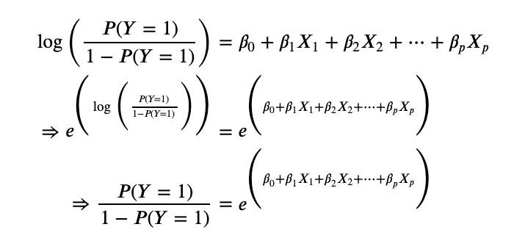

Slide 30
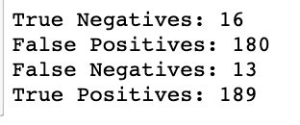

Slide 31


